Slide 1
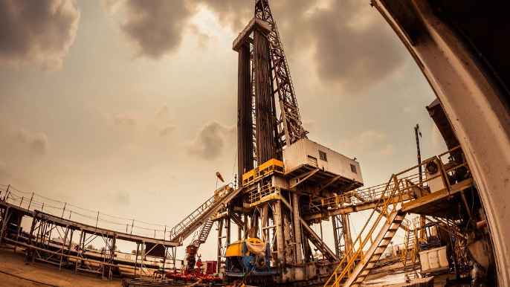
Well Log
Case Study
Well Name : Gorgonichthys-1 (G1)

Slide 2
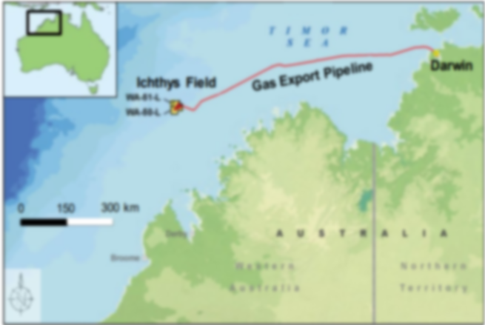
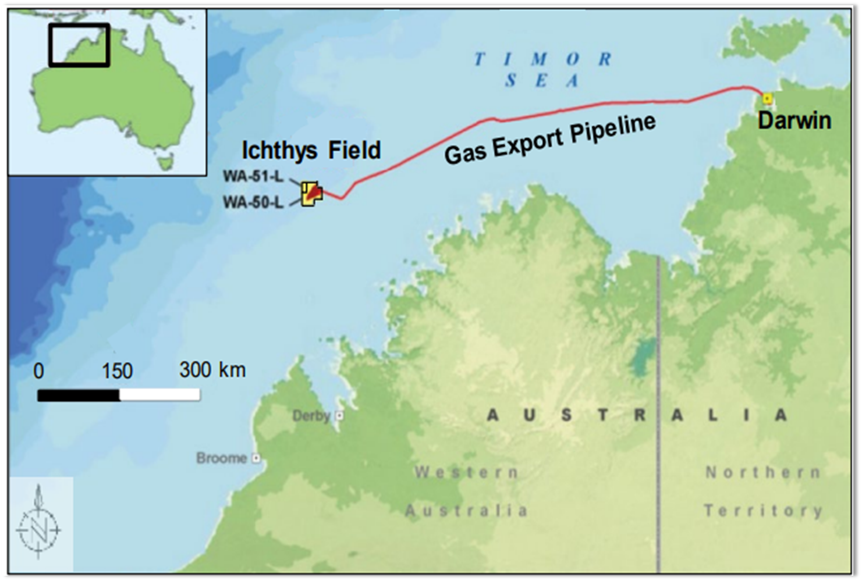
WELL DATA
COMPANY INPEX BROWSE LTD
WELL GORGONICHTHYS-1
PERMIT WA-285-P
REGION BROWSE BASIN, NORTHWEST SHELF
DESIGNATION VERTICAL EXPLORATORY APRAISAL
COORDINATES 013° 58' 41.585" S LAT 123° 07' 35.634" E LONG
SPUD DATE 23RD MAY 2000
WATER DEPTH 260.4 M LAT
REFERENCE ELEVATION RT 26.4 M ABOVE SEALEVEL LAT
TOTAL DEPTH 4767 M MD
CONTRACTOR TRANSOCEAN SEDCO FOREX
RIG MODU SEDCO 703
TYPE SEMI-SUBMERSIBLE
DEPTH 286.8 M TO 4767 M
DATE 23RD MAY - 20TH JULY 2000

Slide 3
Gamma Ray tool
Quality control of data
Calculation of Total porosity
Velocity depth profile
Water Saturation and Reservoir flag
Report about the reservoir zone
TOPICS

Slide 4
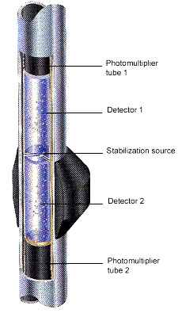

1
GAMMA RAY TOOL
The main applications of the tool is as follow:
Determination of reservoir thickness
Identify rock type / lithology (sandstone, shale, limestone, dolomite etc)
Multi-well stratigraphic correlation (spatial variation)
Volume of shale estimation

Slide 5
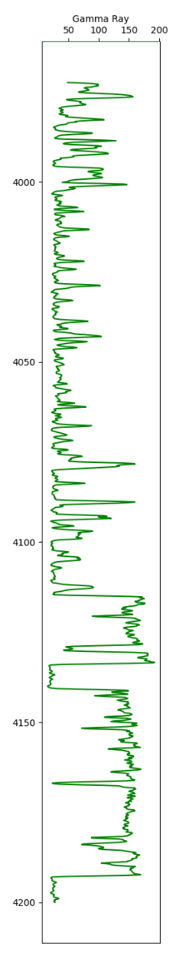
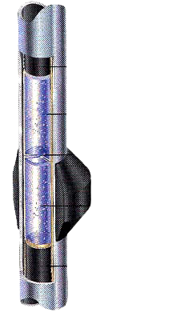
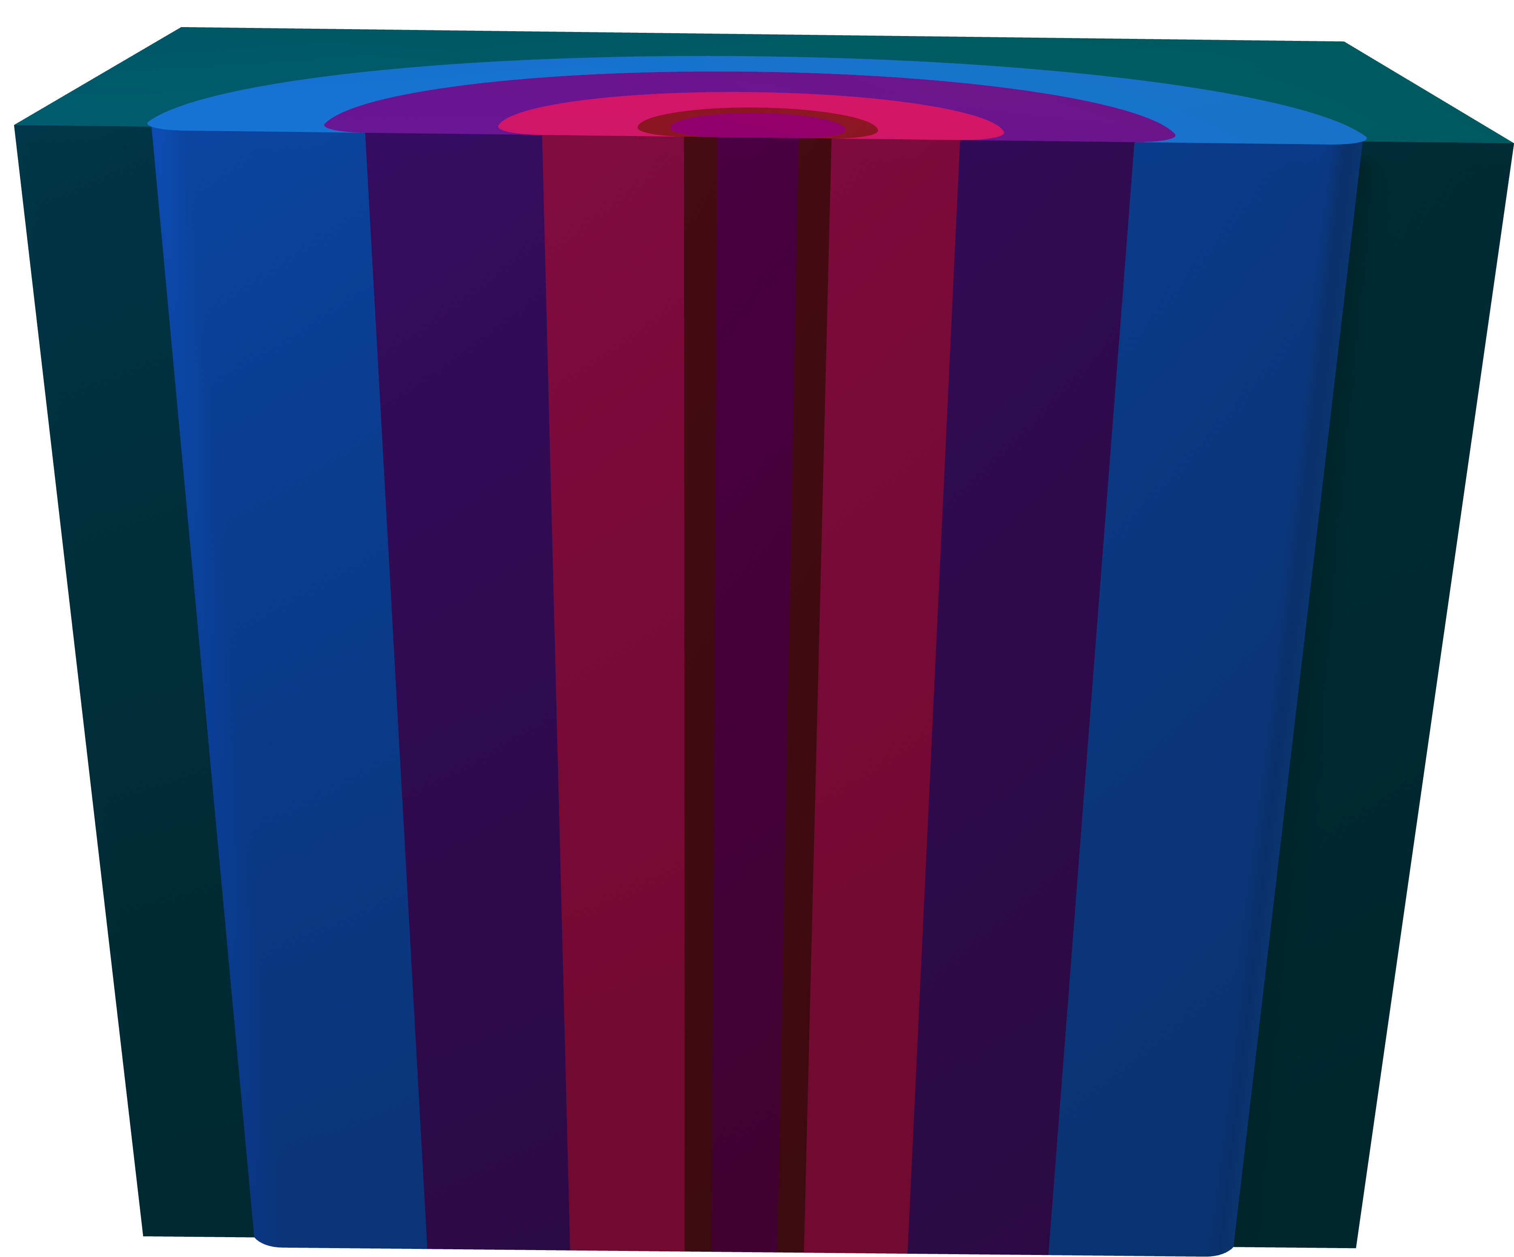
1
GAMMA RAY TOOL
Borehole
Logging of Gamma Ray Tool
The gamma ray tool operates by detecting the natural
gamma radiation emitted by rock formations in a borehole.
The tool is typically lowered into the well on a wireline
cable and pulled up the borehole while collecting data.
The data collected by the gamma ray tool is related to the
concentration of certain radioactive elements in the
subsurface formations.
The tool's scintillation detector produces a voltage signal
in response to gamma radiation, which is amplified,
digitized, and transmitted to the surface for analysis.
GR Tool

Slide 6
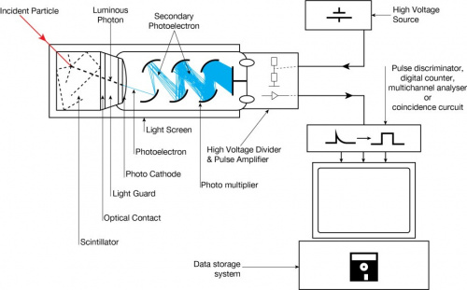
1
GAMMA RAY TOOL
GR DETECTOR - SCINTILLATOR

Slide 7
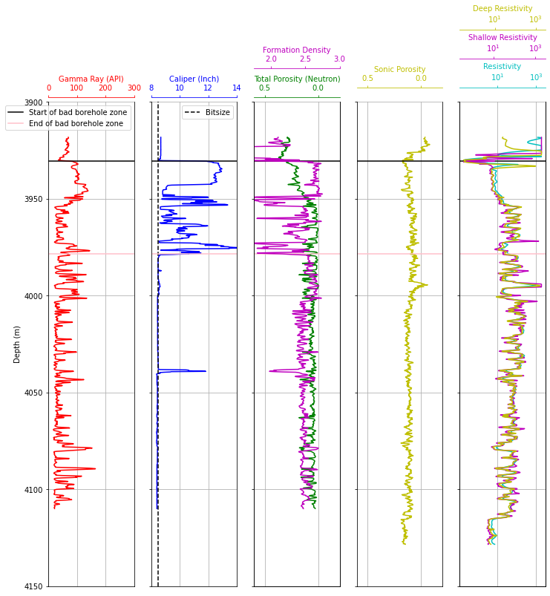
2
QUALITY CONTROLS
Before End Effects of :
Gamma ray
Caliper
Formation Density
Neutron Porosity
Sonic Porosity
Shallow Resistivity
Deep Resistivity
Bad Borehole zone
End effects

Slide 8
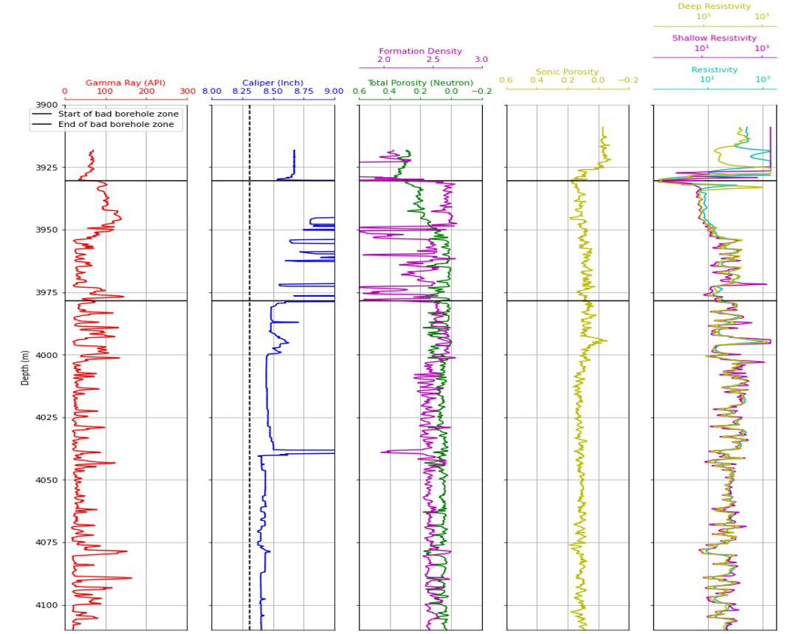
QUALITY CONTROL
2
With End Effects Of :
Gamma ray
Caliper
Formation density
Neutron Porosity
Sonic Porosity
Shallow Resistivity
Deep Resistivity

Slide 9
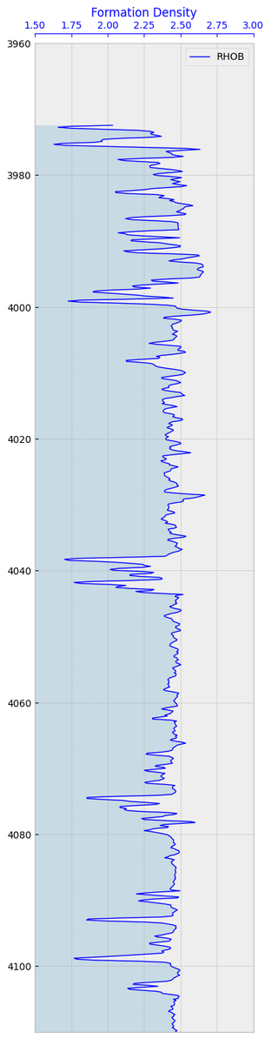
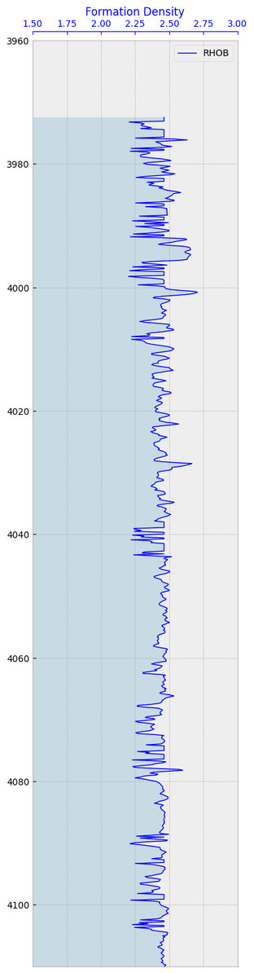
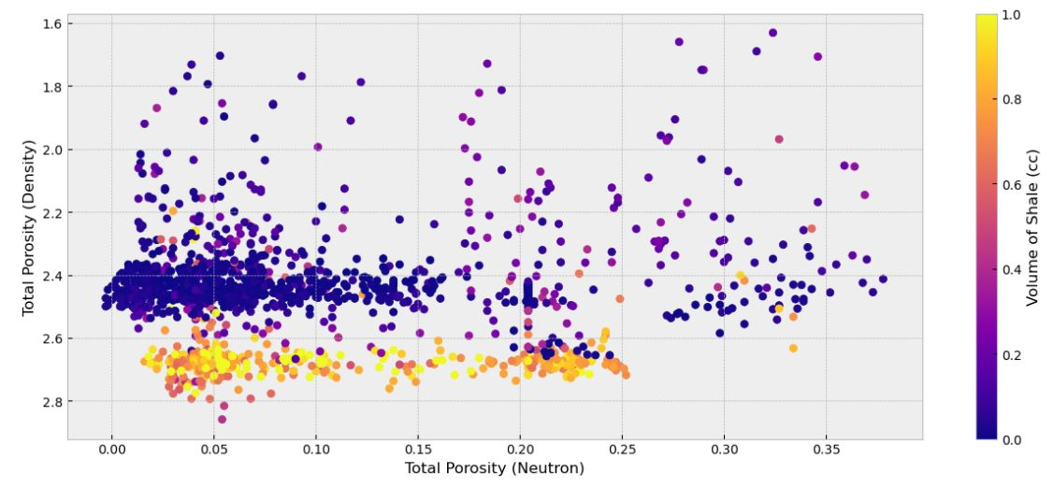
QUALITY CONTROL
For Formation Density :-
2
Outliers
Cross-plot of Density porosity v/s Neutron porosity with
colorbar of Volume of shale :

Slide 10
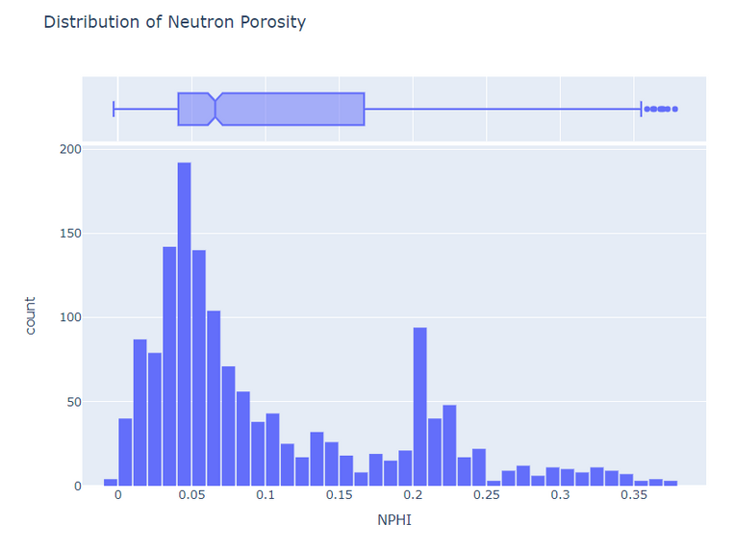
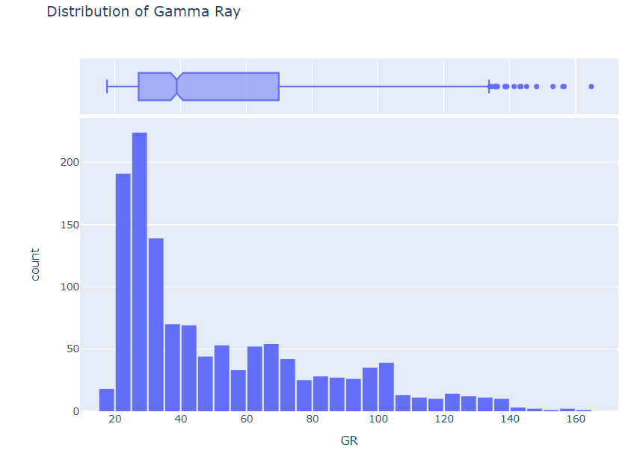
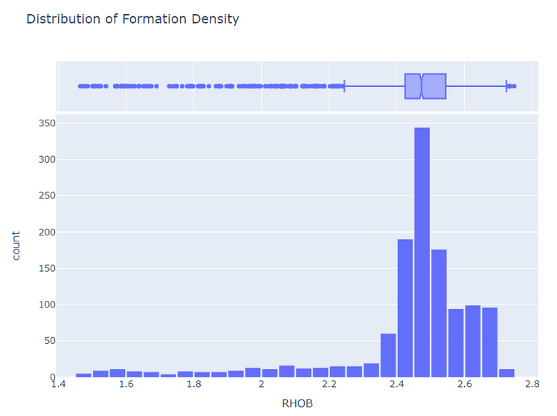
HISTOGRAM PLOTS AFTER REMOVAL OF END EFFECTS

Slide 11
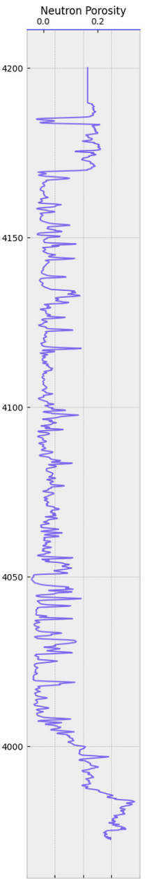
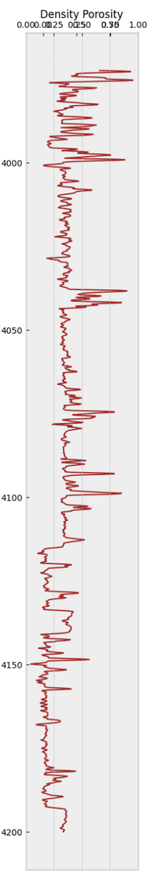
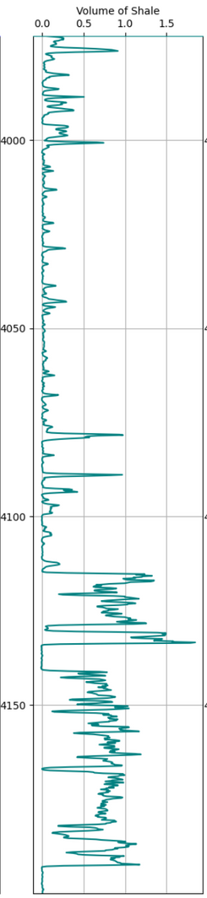
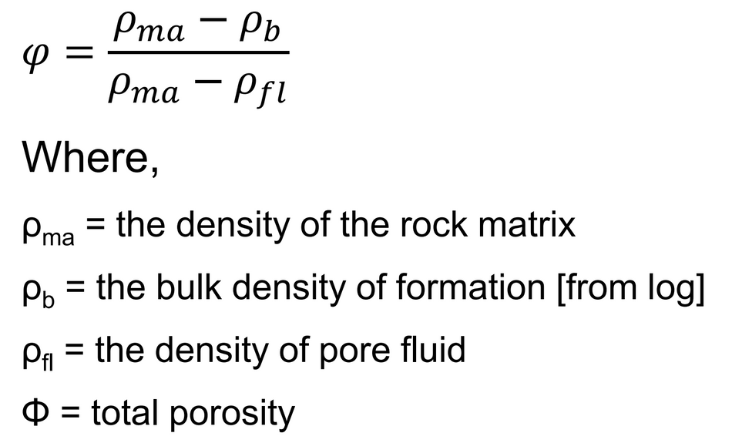
Total Porosity
3

Slide 12
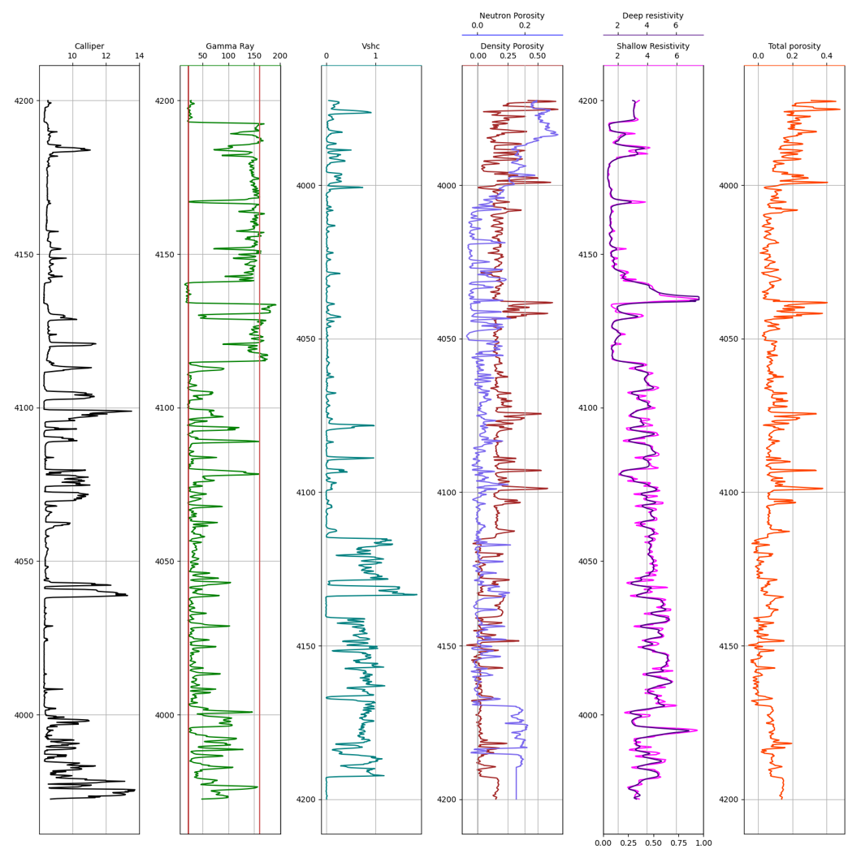
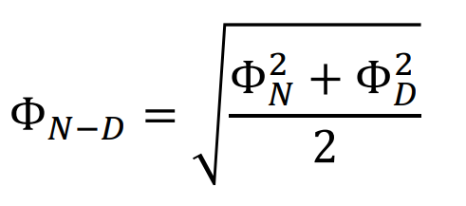
Total Porosity
3
For gas bearing formation:
Combining porosity from neutron NPHI and
density porosity DPHI log.
To calculate total porosity, using the formula

Slide 13
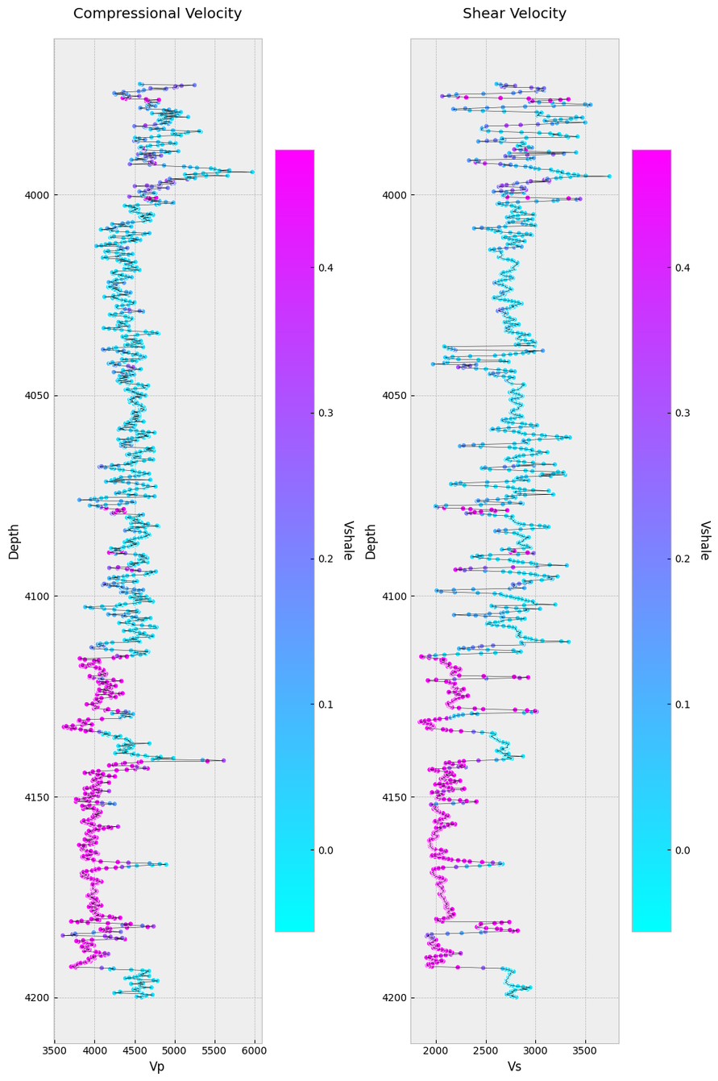
Velocity Depth Profile
4
It provides valuable insights of :
Formation Identification
Formation Thickness
Porosity Estimation
Fluid Identification
Fracture Identification

Slide 14
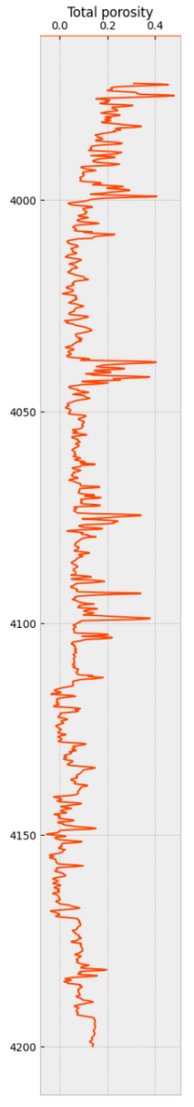
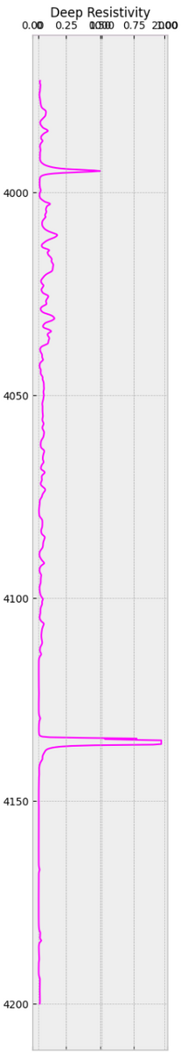
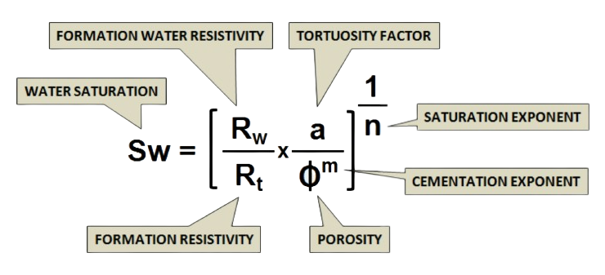
5
Water Saturation
Archie's Method :
where,
a=1
m=n=2

Slide 15
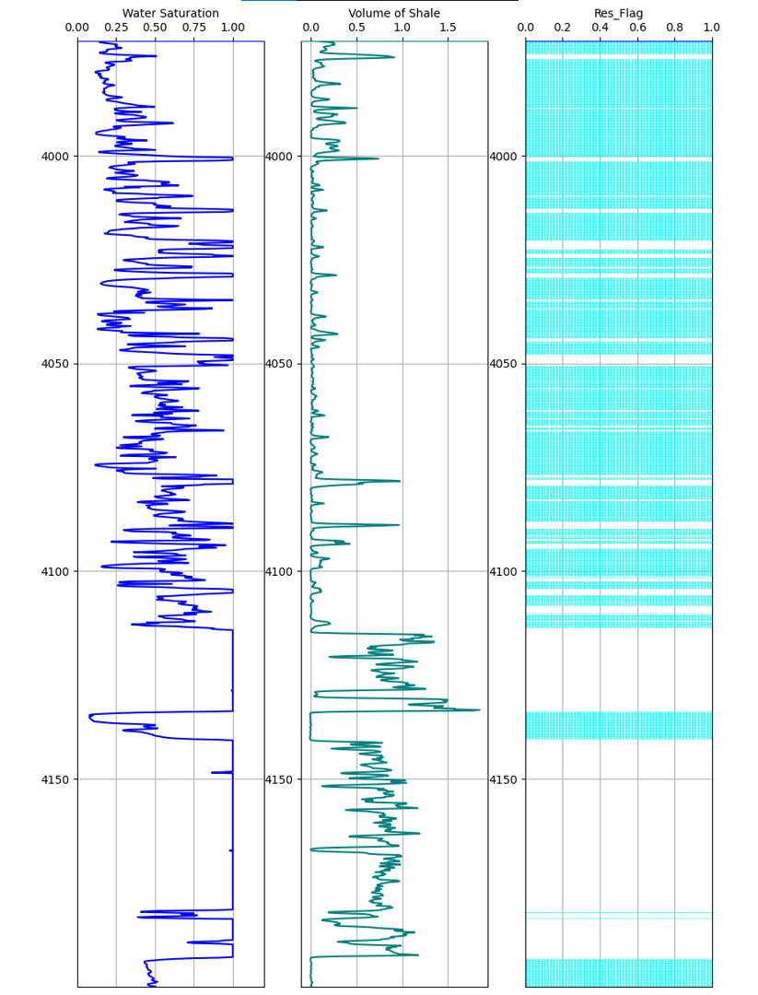
5
Reservoir Flag
For :
Volume of shale, Vsh <= 0.4
Water saturation, Sw <= 0.7.
A lower volume of shale indicates a cleaner formation with fewer barriers to fluid movement.
A lower water saturation suggests a higher potential for hydrocarbon accumulation and production.
These conditions can improve production rates, but accurate predictions require a thorough analysis of multiple data points.

Slide 16
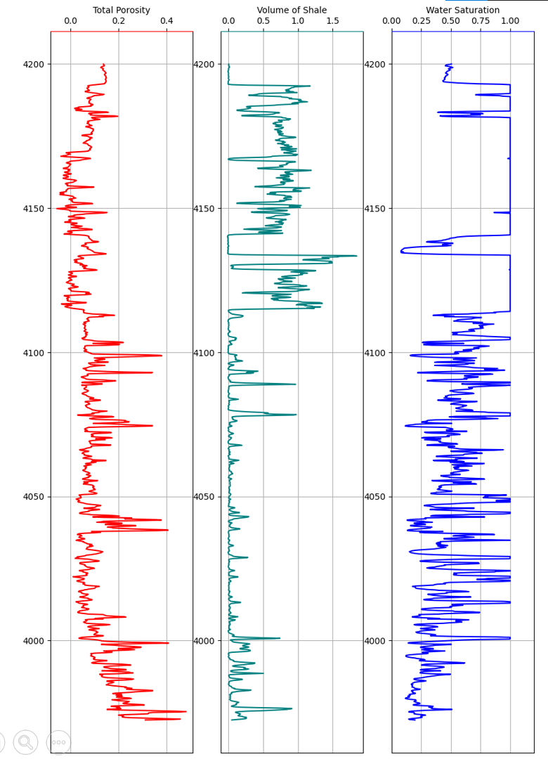
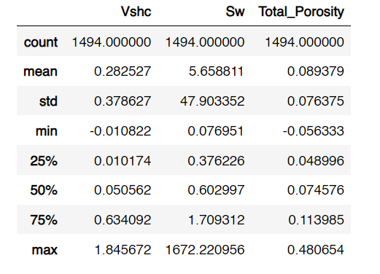
Report
6
For Total porosity, Water saturation, and Volume of shale

Slide 17
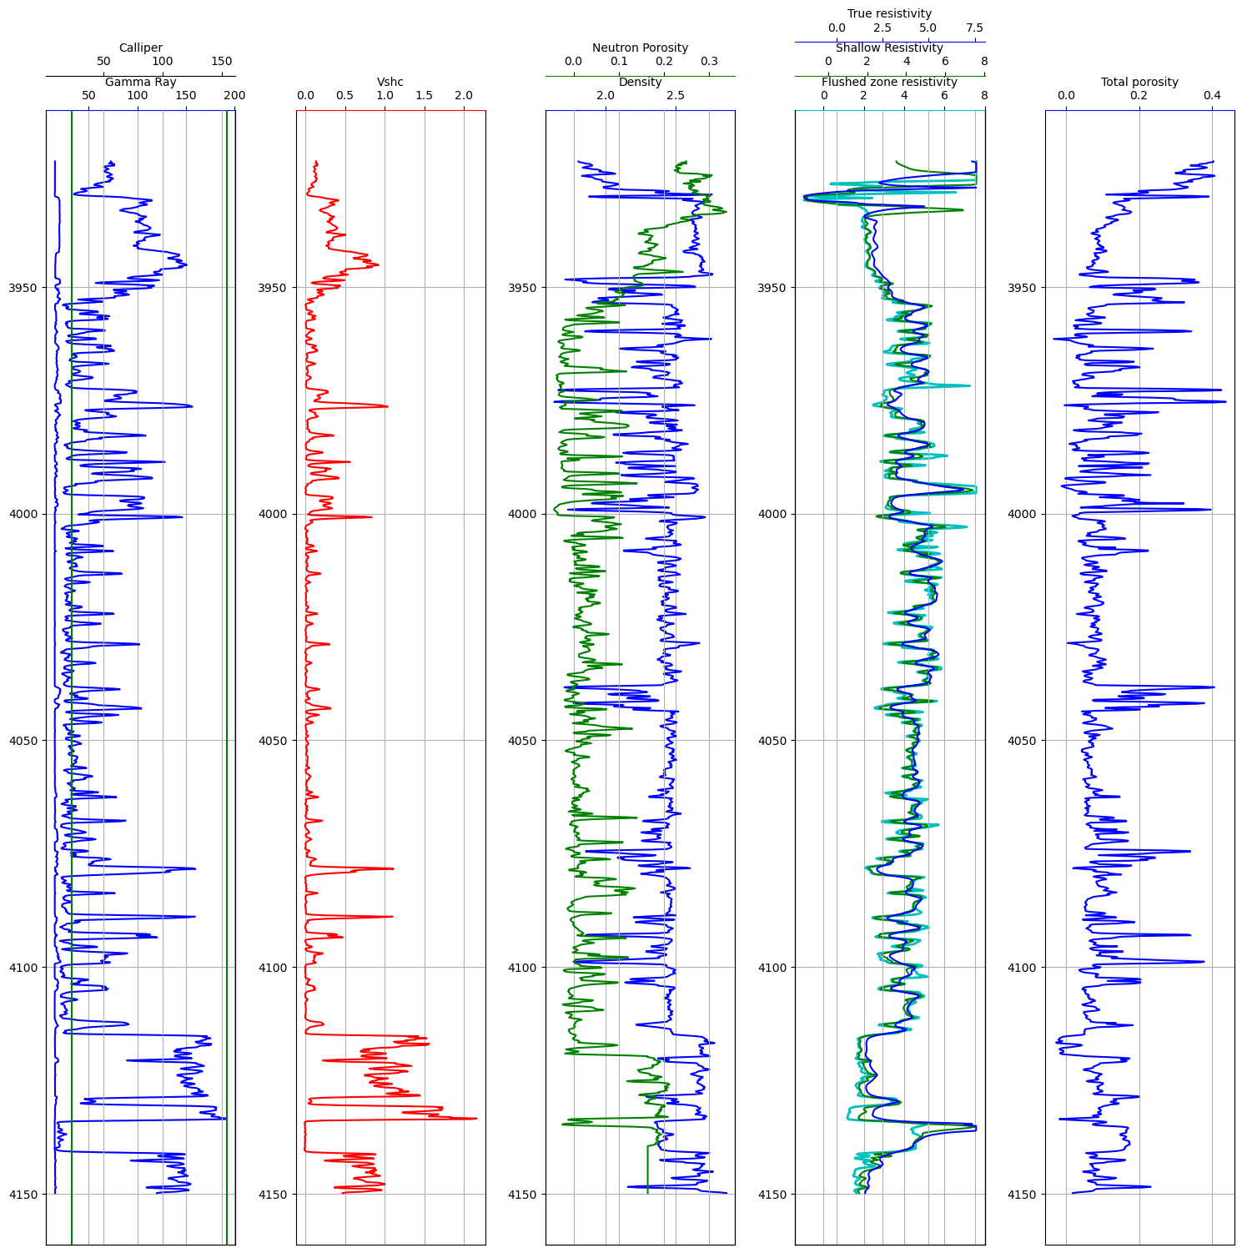
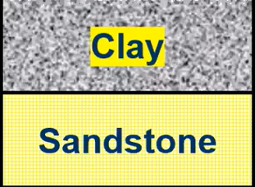
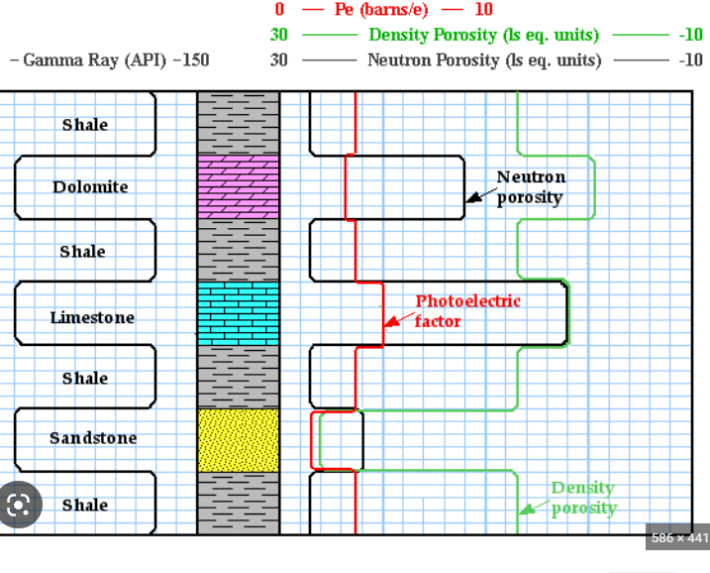
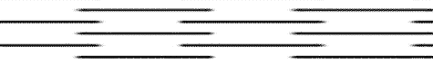
Report
6
End-effects
Bad borehole zone
Berriasian sandstone
Gas bearing
compact
Mudstone
Shaly sand

Slide 18


